Slide 1
IoT IN AGRICULTURE

Slide 2
Need of IoT in Agriculture Sector
Smart farming based on IoT technologies enables growers and farmers to reduce waste and enhance productivity
IoT smart farming solutions is a system that is built for monitoring the crop field with the help of sensors (light, humidity, temperature, soil moisture, crop health, etc.) and automating the irrigation system. The farmers can monitor the field conditions from anywhere. They can also select between manual and automated options for taking necessary actions based on this data.
Data-driven agriculture helps both grow more and better products. Using soil and crop sensors, farmers better understand detailed dependencies between the conditions and the quality of the crops. Using connected systems, they can recreate the best conditions and increase the nutritional value of the products.
The development of agriculture sector will always be a priority especially given the dynamics of the world today. Therefore, using IoT in agriculture has a big promising future as a driving force of efficiency, sustainability, and scalability in this industry.

Slide 3
Smart Irrigation
Smart Irrigation system is an excellent use of IoT system in Agriculture Sector.
Smart irrigation systems improve crop yields while saving water. It has majorly three components :
The irrigation system can apply water efficiently
The use of water is justified
Irrigators can provide proof of the above and are held responsible for their actions
Smart irrigation system also collects moisture level measurements on a server or in the cloud where the collected data can be analysed to plan watering schedules.
Smart irrigation systems also does away with the human error element (e.g. forgetting to turn off a valve after watering the field), and is instrumental in saving energy, time as well as resources.
Smart irrigation systems use IoT devices with soil moisture sensors to determine the amount of moisture in the soil and release the flow of water through irrigation pipes when moisture levels go below a threshold level.

Slide 4
Working Principle
The system can be operated in two modes-I )manual and ii)autonomous.
The manual mode gives option to select the rate of releasing water by pumps, duration of irrigation etc.
The autonomous mode decides the rate of irrigation according to the present physical parameters by the analysis of previous standard surveys uploaded initially in server.
Soil moisture sensors and temperature sensors, which are placed on the fields, send data on a real-time basis.
According to data obtained, the system automatically switches on the water pump and smart sensors make sure that no area is left dry or no area get too much water.
The entire system can be managed by the end-user through a dedicated mobile application.
The pumps can also be controlled from a distant place via web based apps or mobile apps.

Slide 5
Technicalities Used
Sensors
Temperature and humidity sensor
Soil moisture content sensor
PH meter sensor
Water level indicator
Wireless sensor network (WSNs)
Relay system
LED bulbs or indicators
Apps and web servers
and many more…..

Slide 6
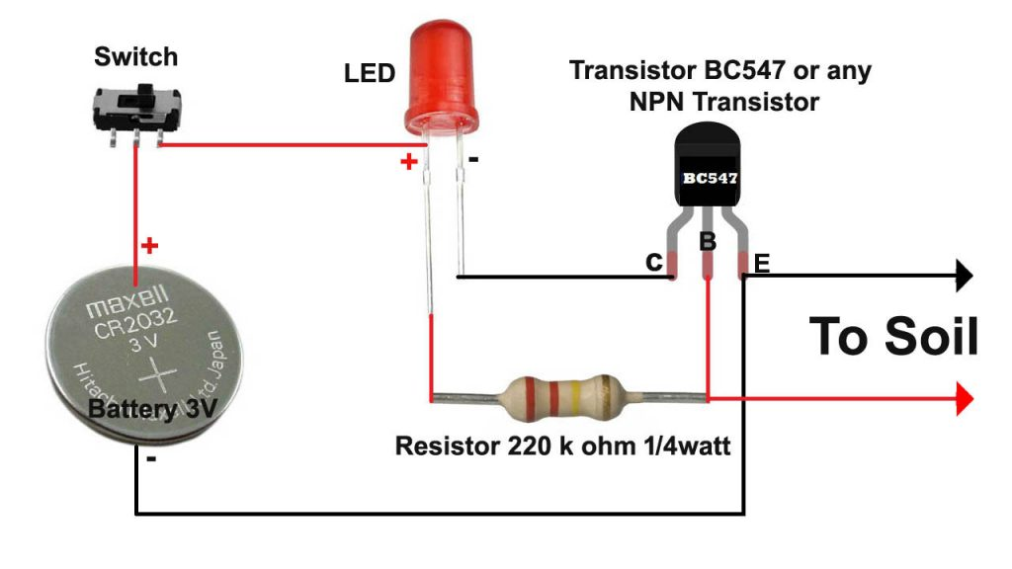
WORKING
Sensors
Soil moisture sensor utilize a soil moisture, sensor placed belowground in the root zone of farms to determine water need. The soil moisture sensor estimates the soil volumetric water content. Volumetric water content represents the portion of the total volume of soil occupied by water. The controllers can be adjusted to open the valves and start irrigation once the volumetric water content reaches a user-defined threshold. The sensor measures the soil moisture content in the root zone before a scheduled irrigation event and bypasses the cycle if the soil moisture is above a specific threshold. Soil moisture sensors must be installed far enough from sprinkler heads, tree roots, sidewalks and walls.
A circuit of npn transistor, battery, LED
and resistor makes a simple sensor
that collects and give data to cloud
through wireless connection.

Slide 7
Temperature and humidity sensor consists of a capacitive humidity sensing element and a thermistor for sensing temperature. In humidity sensing, capacitor change in the capacitance value occurs with the change in humidity levels. The IC measure, process this changed resistance values and change them into digital form.
For measuring temperature this sensor uses a Negative Temperature coefficient thermistor, which causes a decrease in its resistance value with increase in temperature.
An example of this type of sensor is DHT11 The temperature range of DHT11 is from 0 to 50 degree Celsius with a 2-degree accuracy. Humidity range of this sensor is from 20 to 80% with 5% accuracy. The sampling rate of this sensor is 1Hz .i.e. it gives one reading for every second. DHT11 is small in size with operating voltage from 3 to 5 volts. The maximum current used while measuring is 2.5mA.
Water Flow Sensor consists of a plastic valve from which water can pass. A water rotor along with a hall effect sensor is present the sense and measure the water flow. When water flows through the valve it rotates the rotor. By this, the change can be observed in the speed of the motor. This change is calculated as output as a pulse signal by the hall effect sensor. Thus, the rate of flow of water can be measured.

Slide 8
pH meter Sensor relies on a voltage test to determine hydrogen ion levels and thus pH.The more hydrogen ions in a solution, the more conductive it will be. So the more acidic a solution, the more electricity it will conduct.
Wireless sensor networks
It comprises of distributed devices with sensors which are used to monitor the environmental and physical conditions.
It consist of number of end-nodes and routers and a coordinator. End nodes have several sensors attached to them. End nodes also serve as routers.
Routers are responsible for routing the data packets from end-nodes to the coordinator.
Coordinators are gateways that connects the WSN to the internet.
In Smart Irrigation system, WSN is used to monitor soil moisture at various locations.
WSNs are enabled by wireless communication protocols and their power lies in their ability to deploy large number of sensing nodes so that to cover entire farm field.
In fields at the time of failure of some nodes or addition of new nodes the network ,the network can reconfigure itself.

Slide 9
Working of Smart Irrigation system
Smart irrigation system consists of multiple nodes placed in different locations for monitoring soil moisture in a farm field.
The end nodes includes a mini computer like Raspberry Pi and soil moisture sensor.
The sensors embedded in the devices constantly emit data about the field and on the working information of these devices. IoT serves as a platform to dump all the data collected by these devices.
IoT platform includes cloud servers and large databases. The IoT platform acts on the data. It integrates and processes the information. Further, the platform analyses the data thoroughly to gather important details. The platform then sends back instructions based on the data provided.
The end nodes send the data to the cloud and the data is stored in a cloud database. A cloud- based application is used for visualizing the data.
A solenoid valve is used to control the flow of water through irrigation pipes. When the moisture level goes below a threshold, the valve is opened to release water.
Temperature/moisture <-> Gateway <-> Cloud/Server <-> Mobile App
IoT Workflow

Slide 10
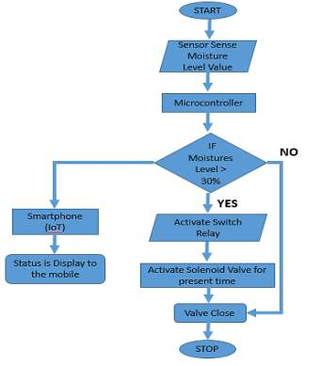
Working Flowchart

Slide 11
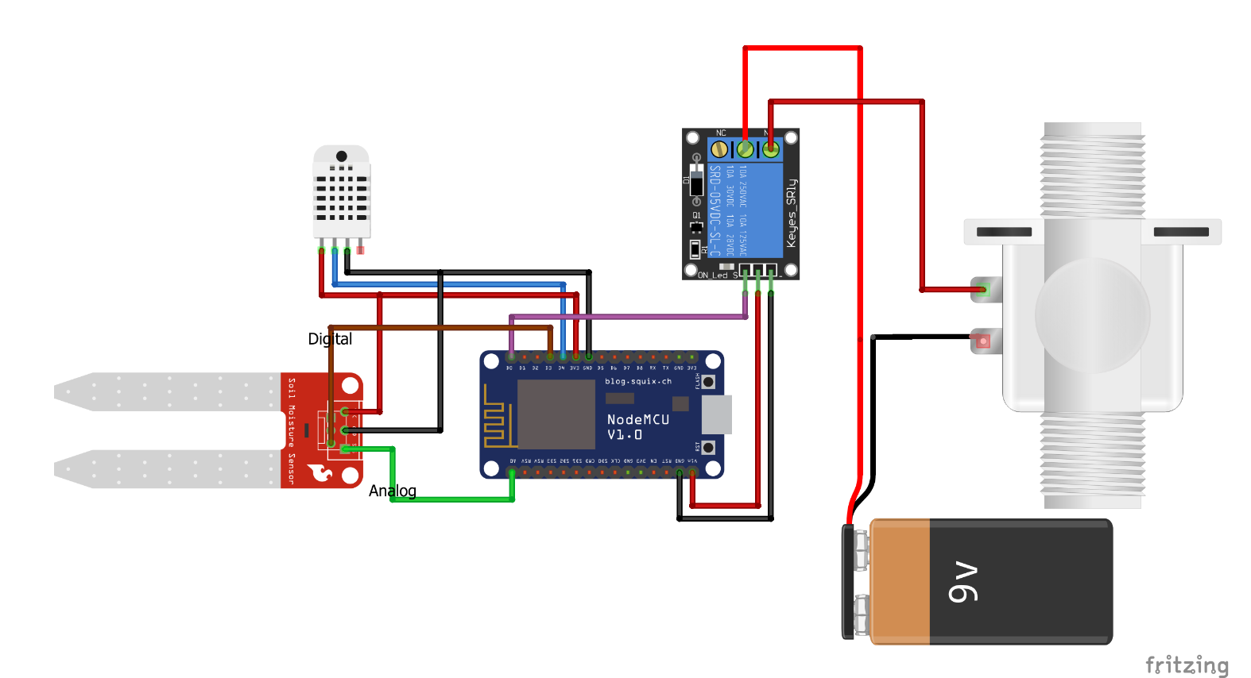
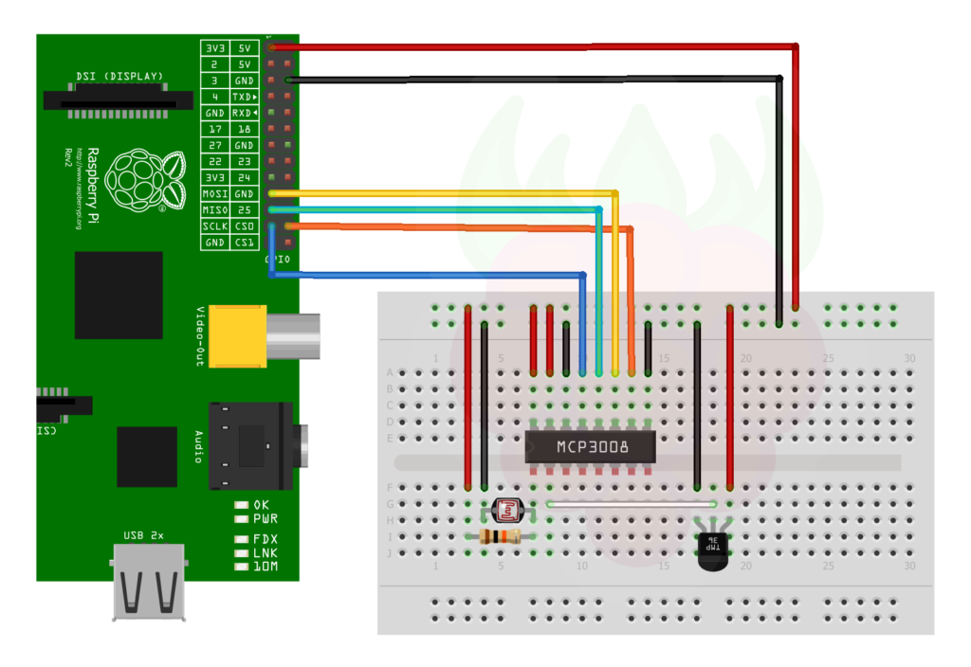
Circuit diagram breadboard circuit of Raspberry Pi & MCP
Schematic diagram of system with Raspberry Pi mini computer and soil moisture sensor and solenoid valve

Slide 12

Python code for Smart Irrigation system using MCP 3008 microcontroller and Raspberry Pi minicomputer having solenoid valve -
https://github.com/Prakhar37/python-code

